Slide 1
SMAIA-X
Adrian Essig, Marco Prescher, Michael Spiegel, Irina Grabher-Meier

Slide 2
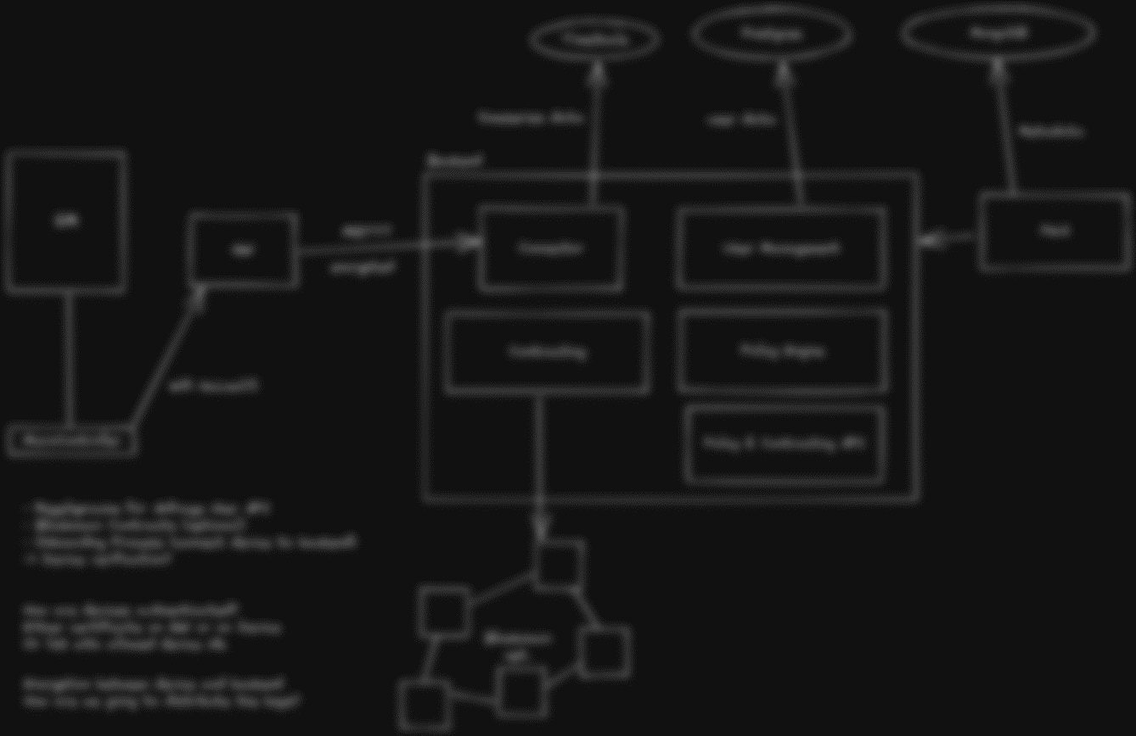
Architecture

Slide 3
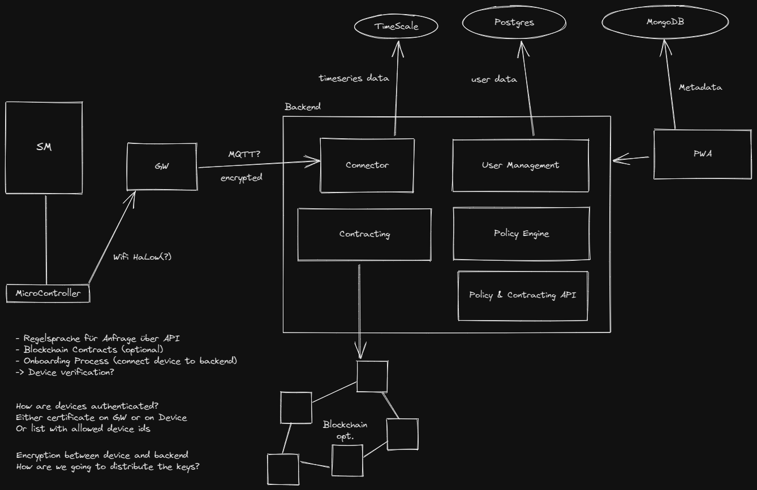

Slide 4
Policy Engine & Contracting
Define rules so that consumers and producers can share their data
Access to data should be given in a dynamic way
Contracts should be created automatically if a match is found
Smart Contracts on Blockchain (optional)
Policy & Contracting API for consumers
Producer is always in charge of who receives which data under which conditions
Policy for choosing to only offer encrypted (homomorphic encryption) data

Slide 5




Additional Challenges
Dynamic configuration of Microcontroller and Gateway (for future changes)
Key Distribution
Onboarding for new devices (How are they identified, Certificate, ID, ...)
Connectivity issues Microcontroller (Basement)
Other teams stealing our ideas...

Slide 6
Out Of Scope Ideas
App for configuring the Gateway and pairing it with WiFi via bluetooth
Training of ML models on encrypted data
Implementation of payment system
Differential Privacy

